Slide 1
Foreign Trade
Balance of payments
Foreign exchange

Slide 2
TRADE
INTRODUCTION
Post depression period
IMPORTANCE
Increase in standard of living
Comparative advantage
Absolute advantage
SIGNIFICANCE
Economic
social

Slide 3
Balance of Payments
Openness of economy
4 sector economy
Balance sheet to incorporate X M
X=M balance of payment equilibrium
X≠M Balance of payment Disequilibrium
Budget surplus
Budget Deficit

Slide 4
Determination of Foreign exchange rate
Price of one currency in terms of another
Market where different currencies are traded is foreign exchange Market
The amount of foreign currency that can be baught with 1 unit of domestic currency
Standard currency
Foreign currency
Domestic currency
Demand and supply of foreign currency

Slide 5
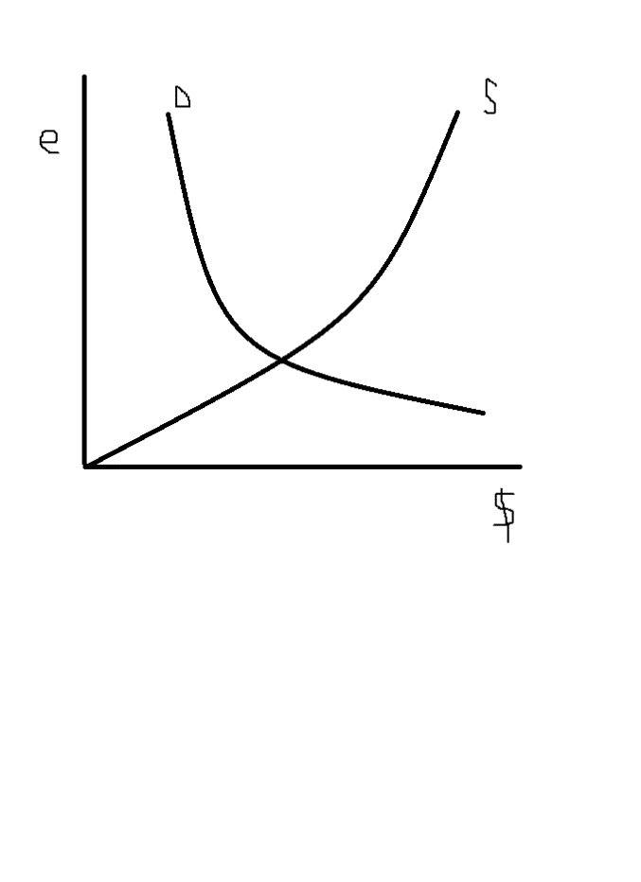
Foreign Exchange market

Slide 6
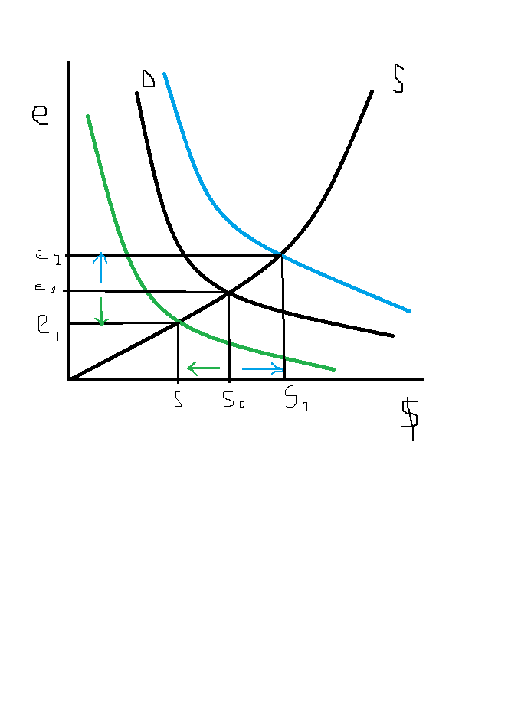
Effects of changes in trade

Slide 7
Types of Exchange rates
FIXED EXCHANGE RATES
Govt specifies
FLEXIBLE EXCHANGE RAETES
demand and supply

